Slide 1
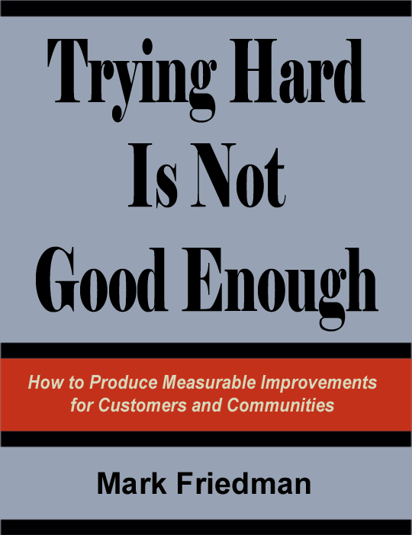
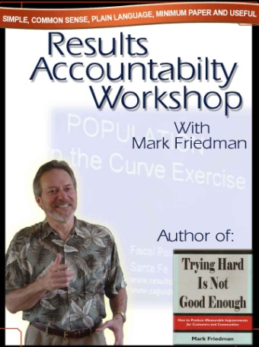
Results-Based
Accountability (RBA)
AKA: Outcome-Based Accountability (OBA)
The Fiscal Policy Studies Institute
Websites
raguide.org
resultsaccountability.com
Book - DVD Orders
amazon.com
resultsleadership.org
Notes:
Sometimes you only have 20 minutes to present the basic ideas of Results Accountability. Here is a selected set of slides that I have used in that situation. You may want to replace the results examples and the turn the curve examples with slides you’re more familiar with. Good luck.
Mark

Slide 2
Results Based Accountability is made up of two parts:
Population Accountability
about the well-being of
WHOLE POPULATIONS
For Communities – Cities – Counties – States - Nations
Performance Accountability
about the well-being of
CUSTOMER POPULATIONS
For Programs – Agencies – and Service Systems
Notes:
Introduction and the difference between population and performance accountability: We are going to talk about two different kinds of accountability: Accountability for whole populations, like all children in Los Angeles, all elders in Chicago, all residents of North Carolina. This first kind of accountability is not the responsibility of any one agency or program. If we talk for example about “all children in your community being healthy,” who are some of the partners that have a role to play? Notice that the traditional answer is “It’s the health department.” It’s got the word health in it and so it must be the responsibility of the health department. And yet one of the things we have learned in the last 50 years is that the health department by itself can’t possibly produce health for all children without the active participation of many other partners. And that’s the nature of this first kind of accountability. It’s not about the health department. It’s about the kind of cross community partnerships necessary to make progress on quality of life for any population. Now the second kind of accountability, Performance Accountability, is about the health department. It’s about the programs and services we provide, and our role as managers, making sure our programs are working as well as possible. These are two profoundly different kinds of accountability. We going to talk about how to do each one well and then how they fit back together again.

Slide 3
THE LANGUAGE TRAP
Too many terms. Too few definitions. Too little discipline
Benchmark
Outcome
Result
Modifiers
Measurable Core
Urgent Qualitative
Priority Programmatic
Targeted Performance
Incremental Strategic
Systemic
Indicator
Goal
Measure
Objective
Target
Core qualitative strategic objectives
Your made up jargon here
Measurable urgent systemic indicators
Lewis Carroll Center for Language Disorders
Notes:
The Language Trap: Now you’ve seen all these words before. Read the outer ring of words. And then you get these modifiers in the middle. Read some or all of the inner ring of words. This page is the Jargon Construction Kit. If you want to sound fancy about this work, just pick three or four words off this page at random and string them together. Give example: “Measurable urgent systemic indicators,” whatever the hell that means. And I guarantee you’ll get away with it too, because people will be too embarrassed to ask you what you mean. I have a new rule, that anyone who uses three or more of these words in the same sentence doesn’t know what they’re talking about. It’s very common for two people to be in the same meeting using the same word. They have two entirely different ideas of what that word means, and they’re just talking right past each other. Has this ever happened to you?

Slide 4
DEFINITIONS
RESULT or OUTCOME
RESULT
A condition of well-being for
children, adults, families or communities.
Children born healthy, Children ready for school,
Safe communities, Clean Environment, Prosperous Economy
Children born healthy
Children ready for school
Safe communities
Clean Environment
Prosperous Economy
Population
Population
INDICATOR
INDICATOR or BENCHMARK
A measure which helps quantify the achievement
of a result.
Rate of low-birthweight babies, Percent ready at K entry,
crime rate, air quality index, unemployment rate
Rate of low-birthweight babies
Percent ready at K entry
crime rate
air quality index
unemployment rate
PERFORMANCE MEASURE
PERFORMANCE MEASURE
A measure of how well a program, agency or service
system is working.
Three types:
Performance
Performance
1. How much did we do?
2. How well did we do it?
3. Is anyone better off?
= Customer Results
= Customer Results
Notes:
So what we did a few years ago is develop a set of definitions that would allow us to have a disciplined conversation about this very complex work we’re trying to do. Now the purpose of these definitions is not to impose words on people. Words like “result” or “outcome” are just labels for ideas. If you think about if for a minute, that’s what words are, labels for ideas. And the same idea can have many different labels. What’s important here are not the labels. You can pick whatever labels you like. What important are the ideas, and that we manage to keep three ideas separate at the beginning of this work. Read the ideas and the examples for Results and Indicators.
Now this last category, performance measures…. Are measures of how well a program, agency or service system is working. Now there are many different ways to categorize performance measures, but I believe that all performance measures can be categorized into one of these three categories: How much did we do? How well did we do it? Is anyone better off? And this last category we sometimes call “customer results” or “customer outcomes.”
And if you do nothing else in terms of your language convention, I would strongly encourage you…. That whenever you want to use a word like “outcome” or “result” and you’re talking about a program or agency, put a modifier in front of it. Call if “program results” or “client outcomes,” something to distinguish it from the use of the words results and outcome to mean the whole population. This is the single biggest source of language confusion in the U.S. today.
The Language of Accountability
From www.raguide.org
The most common problem in this work is the problem of language. People come to the table from many different disciplines and many different walks of life. And the way in which we talk about programs, services and populations varies, literally, all over the map. This means that the usual state of affairs in planning for children, families, adults, elders and communities is a Tower of Babel, where no one really knows what the other person is saying, but everyone politely pretends that they do. As a consequence, the work is slow, frustrating and often ineffective.
It is possible to exercise language discipline in this work. And the way to do this is to agree on a set of definitions that start with ideas and not words.
Words are just labels for ideas. And the same idea can have many different labels. The following four ideas are the basis for definitions used at the beginning of this work. Alternative labels are offered:
Results (or outcomes or goals) are conditions of well-being for children, adults, families or communities, stated in plain English (or plain Spanish, or plain Korean...). They are things that voters and taxpayers can understand. They are not about programs or agencies or government jargon. Results include: "healthy children, children ready for school, children succeeding in school, children staying out of trouble, strong families, elders living with dignity in setting they prefer, safe communities, a healthy clean environment, a prosperous economy." (An interesting alternative definition of a result is provided by Con Hogan: "A condition of well-being for people in a place - stated as a complete sentence." This suggests a type of construction for a result statement as "All ______ in ______ are _____." e.g. All babies in Vermont are born healthy.")
Indicators (or benchmarks) are measures which help quantify the achievement of a result. They answer the question "How would we recognize these results in measurable terms if we fell over them?" So, for example, the rate of low-birthweight babies helps quantify whether we're getting healthy births or not. Third grade reading scores help quantify whether children are succeeding in school today, and whether they were ready for school three years ago. The crime rate helps quantify whether we are living in safe communities, etc.
Strategies are coherent collections of actions which have a reasoned chance of improving results. Strategies are made up of our best thinking about what works, and include the contributions of many partners. No single action by any one agency can create the improved results we want and need.
Performance Measures are measures of how well public and private programs and agencies are working. The most important performance measures tell us whether the clients or customers of the service are better off. We sometimes refer to these measures as client or customer results (to distinguish them from cross-community population results for all children, adults or families). It is sometimes useful to distinguish "program performance measures," from "agency performance measures" from "service system performance measures."
The principal distinction here is between ends and means. Results and indicators are about the ends we want for children and families. And strategies and performance measures are about the means to get there. Processes that fail to make these crucial distinctions often mix up ends and means. And such processes tend to get mired in the all-talk-no-action circles that have disillusioned countless participants in past efforts. You actually have choices about which labels to use in your work. And clarity about language at the start will help you take your work from talk to action.
What Mission and Vision, Values, Goals, Objectives, Problems, Issues
Inputs and Outputs?
Many of us have grown up with these traditional words in strategic planning and budgeting. Where do they fit?
First, remember that words are just labels for ideas. These seven words have no natural standard definition that bridges across all the different ways they are used. They are terms of art which can and are used to label many different ideas. This is why we pay so much attention to getting language discipline straight at the very beginning. It's the ideas that are important not the words. So you can choose to label the ideas in this guide with any words you like, provided you are consistent.
The word "mission" is usually used in relation to an organization, agency, program, initiative or effort. It is therefore mostly used in connection with agency or program performance accountability. Mission statements are usually concise statements of the purpose of an organization, sometimes also telling why and how the organization does what it does. Mission statements can be useful tools in communicating with internal and external stakeholders. It is possible to construct a mission statement from the performance measurement ideas in the upper right ("How well did we deliver service?") and lower right ("Is anyone better off?") quadrants of the performance measurement framework: For example: "Our mission is to help our clients become self sufficient ("Is anyone better off?" lower right) by providing timely, family friendly, culturally competent job training services ("How well did we deliver service?" upper right)." One mistake that is often made is that organizations spend months and sometimes years trying to craft the perfect mission statement before any other work can proceed. In the FPSI framework, mission statements are set aside, allowing the work of identifying and using performance measures to proceed quickly. Then, on a parallel track a small group can, if it is useful, use the work of the performance measurement groups to craft a workable mission statement.
The word "vision" is often used to convey a picture of a desired future, often one that is hard but possible to attain. This is a powerful idea. And in fact one can think of the set of desired results for children and families as one way of articulating such a vision. "We want our community to be one which is safe and supportive, where all children are healthy and ready for school, where all children succeed in school, and grow up to be productive and contributing adults." This is an example of a vision statement made up of desired results or ends. It is possible to craft such a statement before or after the development of results.
The word "values" in some ways defies definition. It is about what we hold most dear, how we view right and wrong, how we believe we should act, and how those beliefs are, in fact, reflected in our actions. Our values underlie all of the work we do. And that is nowhere more true than in the work on the well-being of children, families and communities. Our values will guide our choice of results for children and families and the decisions we make about how we and our partners take action to improve those results.
The word "goal" is often used interchangeably with "result and outcome" to label the idea of a condition of well-being for children, adults, families or communities (as in the case of Georgia, Missouri and Oregon for example). The word goal has many other common usages as well. It often serves as an all-purpose term to describe a desired accomplishment. "My goal for this month is to fix the roof." "Our goal is to increase citizen participation in the planning process." " The primary goal of the child welfare system is to keep children safe." and so forth. The word goal (or target) is sometimes used to describe the desired future level of achievement for an indicator or performance measure. "Our goal is 95% high school graduation in 5 years." "Our goal is to improve police response time to under 3 minutes." These are widely different usages. Still another use of the word "goal" is in relation to an implementation plan. Given a strategy and action plan to improve a particular result (children ready for school for example), it is possible to structure the action plan as a series of planned accomplishments (goals) with timetables and assigned implementation responsibility. For example, a goal in a "children ready for school plan" might be to "increase funding for child care by 25% this year and 50% next year." This is a specific action which will contribute to achieving the result. There is nothing wrong with any of these usages, provided they are clearly distinguished, used consistently and do not confuse the underlying concepts labeled results, indicators, strategies and performance measures discussed above.
The word "objective" is often paired with the word goal to specify what amount to a series of "subgoals" required to achieve the "higher" goal. The set of terms "mission, goal and objective" have a long history in the military to describe the strategic and tactical components of a large or small action or engagement. And some of their usage in the business sector and the public and private service sector derives from this history. In this framework, the terms goal and objective are most often used to structure the action plan and specify who will do what, how, and by when.
The words "problem" and "issue" are used in more ways that just about any planning term. They can be used to describe almost anything. "The problem with this computer is that the keyboard is too small." "The problem with our community is that there is not a safe place for children to play." "We must solve the issue of affordability if we are to provide child care for all who need it." These are three different uses of the words and there are countless others. Again, there is nothing wrong with any of these usages, provided that they do not interfere with the language discipline discussed above about ends and means.
The words "input" and "output" are commonly used categories for performance measures. There is no standard usage. The word "input" is most often used to describe the staff and financial resources which serve to generate "outputs." "Outputs" are most often units of service.
Change Agent vs. Industrial Models: Much of the tradition of performance measurement comes from the private sector and in particular the industrial part of the private sector. Work measurement - dating back to the time and motion studies of the late 19th and early 20th centuries - looked at how to improve production. Industrial processes turn raw materials into finished products. The raw materials are the inputs; the finished products are the outputs.
This model does not translate very well to public or private sector enterprises which provide services. It does not make much sense to think of clients, workers and office equipment as inputs to the service sausage machine, churning out satisfied, cured or fixed clients. Instead we need to begin thinking about services in terms of the change agent model. In this model, the agency or program provides services which act upon the environment to produce demonstrable changes in the well-being of clients, families, or communities. If the input/output language is maintained, then providing service is the input, change in customers' lives is the output.
One common situation illustrates the problems which arise when industrial model thinking is applied to services. It is the belief that the number of clients served is an output. ("We have assembled all these workers in all this office space; and we are in the business of processing unserved clients into served clients.") This misapplication of industrial performance concepts to services captures much of what is wrong with the way we measure human service performance today. "Number of clients served" is not an output. It is an input, an action which should lead to a change in client or social conditions - the real output we're looking for. ("We served 100 clients - input - and 50 of them got jobs - output - and 40 of them still had jobs a year later - even more important output.") This is a whole different frame of mind and a whole different approach to performance measurement.
A closely related industrial model problem involves treating dollars spent as inputs, and clients served as outputs. In this distorted view, dollars are raw materials, and whatever the program happens to do with those dollars are outputs. It's easy to see why this over-simplification fails to meet the public's need for accountability. In this construct, the mere fact that the government spent all the money it received is a type of performance measurement. This is surely a form of intellectual, and perhaps literal, bankruptcy. In this perverse scheme, almost all the agency's data is purportedly about outputs. This gives the agency the appearance of being output-oriented and very progressive. It just doesn't happen to mean anything.
Much of the confusion about performance measurement derives from the attempt to impose industrial model concepts on change agent services. The best model would be one which could span industrial and change agent applications. Some government services still involve industrial-type production (although these are often the best candidates for privatization and a diminishing breed.) In other cases, discussed below, the service itself, or components of the service, have product-like characteristics and industrial model concepts apply well. But most government and private sector human services fall into the change agent category. The approach to performance measurement described in this website can be used for either industrial or change agent applications. (Excerpt from "A Guide to Developing and Using Performance Measures, Finance Project, 1997)

Slide 5
From Ends to Means
From Talk to Action
From Talk to Action
RESULT or OUTCOME
Population
ENDS
INDICATOR or BENCHMARK
PERFORMANCE
MEASURE
MEANS
Performance
Customer result = Ends
Service delivery = Means
Notes:
Now the principle distinction here is between ends and means. Results and Indicators are about ends. And performance measures tell us whether the particular programmatic means we’ve chosen to get there is working properly. Does that make sense. What we see as we look at the work around the country is that people are typically working on all three of these things, but it’s all mixed up in a hopeless soup of language. So one minute we’re talking about a condition of well being (result) and the next minute it’s a piece of data that measure that…. And the next minute a little program on the east side of town…. As if these were all the same thing and these distinctions really didn’t matter. And what happens when people mix up ends and means like that is that they get stuck. They start to circle and circle. The work becomes all talk and talk and talk. And we’ve all had experiences with process that are all talk. The talk is not what’s important here. What’s important is how we get from talk to action. And everything in this presentation is about that single simple challenge. How do we get from talk to action in a disciplined way. And I think the starting point is to have a common language.
Within performance measures, we have another ends means distinction, like smaller Russian dolls nested inside larger dolls. Here, customer results become the ends and the services we provide become the means.

Slide 6
POPULATION
ACCOUNTABILITY
For Whole Populations
in a Geographic Area

Slide 7
Community Outcomes
for Christchurch, NZ
● A Safe City
● A City of Inclusive and Diverse Communities
● A City of People who Value and Protect the Natural
Environment
● A Well-Governed City
● A Prosperous City
● A Healthy City
● A City for Recreation, Fun and Creativity
● A City of Lifelong Learning
● An Attractive and Well-Designed City

Slide 8
Every Child Matters – Children Act
Outcomes for Children and Young People
Being Healthy: enjoying good physical and mental health and living a healthy lifestyle.
Staying Safe: being protected from harm and neglect and growing up able to look after themselves.
Enjoying and Achieving: getting the most out of life and developing broad skills for adulthood.
Making a Positive Contribution: to the community and to society and not engaging in anti-social or offending behaviour.
Economic Well-being: overcoming socio-economic disadvantages to achieve their full potential in life.

Slide 9
Georgia Policy Council
for Children and Families
RESULTS
● Healthy Children
● Children Ready for School
● Children Succeeding in School
● Strong Families
● Self Sufficient Families
Notes:
This list comes from the Georgia Policy Council for Children and Families and is used by the network of Family Connections Councils in Georgia. Georgia has gone one step further and identified 25 indicators to tell if these conditions are being achieved. And Georgia has produced a report card at the state level and for each of the 159 counties.
Many other places in the United States have produced such report cards, including
CALIFORNIA
Contra Costa County: www.cccoe.k12.ca.us
San Mateo County: www.pls.lib.ca.us/healthysmc/33/children.pdf
Santa Cruz County: appliedsurveyresearch.org/cap_report.htm
Silicon Valley Joint Venture: jointventure.org
GEORGIA
Georgia Policy Council for Children and Families, and The Family Connection:
gpc-fc.org
MINNESOTA
Hennepin County: www.co.hennepin.mn.us/opd/opd.htm
OHIO
Montgomery County Family and Children First Council:
http://www.fcfc.montco.org
OREGON
Oregon Progress Board: econ.state.or.us/opb
PENNSYLVANIA
Philadelphia Safe and Sound: Children's Report Card and Children's Budget
www.philasafesound.org
VERMONT
Agency for Human Services: Community Profiles: ahs.state.vt.us
. Links to the best of these sites can be found on www.raguide.org.

Slide 10

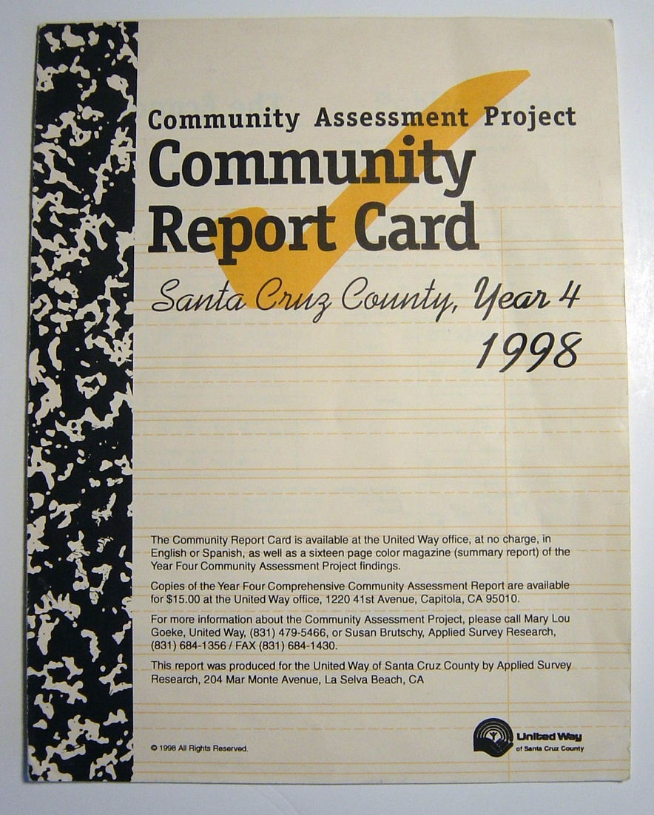
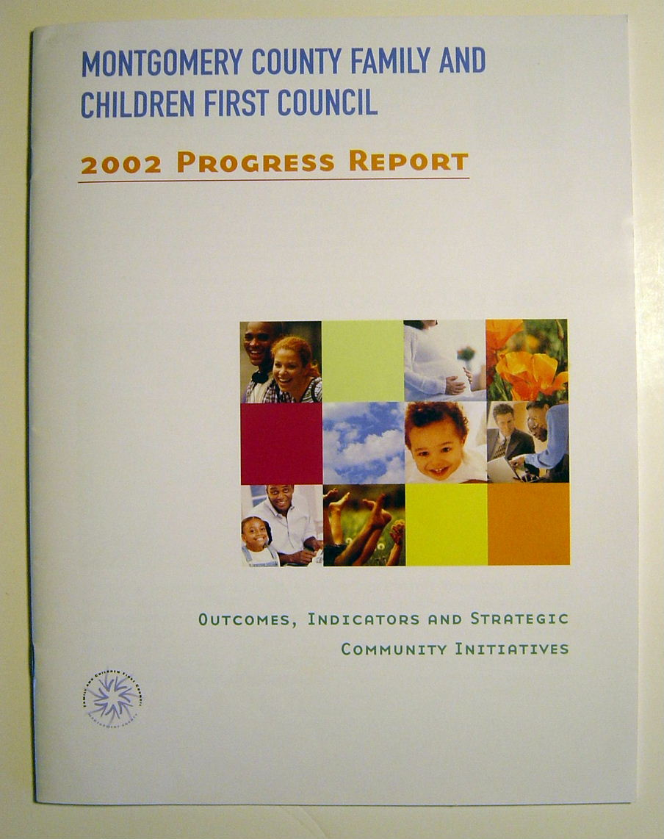

REPORT CARDS
Georgia
Santa Cruz, CA
Dayton, OH
Lehigh Valley, PA
Notes:
There is a growing number of report cards on child, family and community well-being being developed across the U.S. and in other countries. Here are four such report cards from Georgia,, Dayton Ohio and Santa Cruz County California and the Lehigh Valley, PA

Slide 11


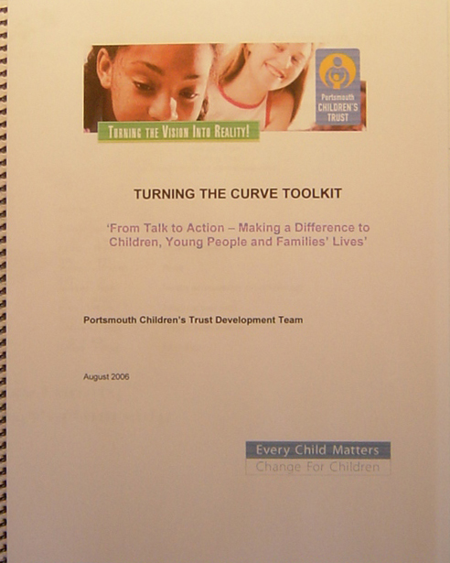
Country
Neighborhood
New Zealand
City
Kruidenbuurt
Tilburg, Netherlands
Portsmouth, UK

Slide 12
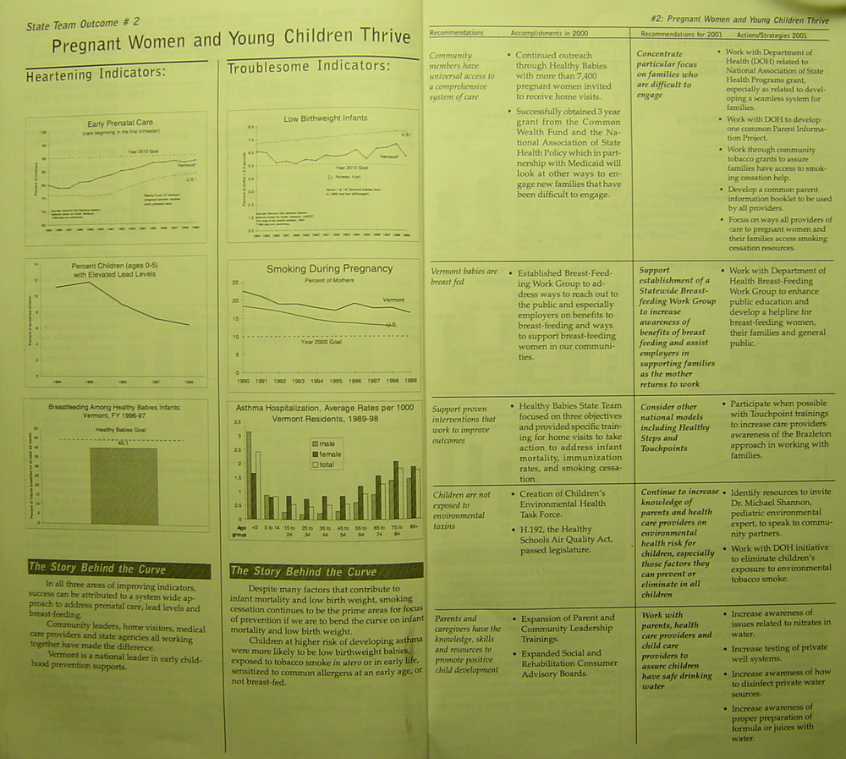

Slide 13
Leaking Roof
(Results thinking in everyday life)
Experience
Inches of Water
BASELINE
Not OK
Measure
? Fixed
Turning the Curve
Story behind the baseline (causes)
Partners
What Works
Action Plan #2
Action Plan
Notes:
LEAKING ROOF
1. Ask "How many people here have ever had a leaking roof?" (Most hands will go up.)
2. How can you tell if the roof is leaking? ("Water on the floor, down the walls etc.") So, this is how you might "experience" a leaking roof.
3. How could you measure how badly the roof is leaking? ("By how much water...") So you might put out a bucket and measure the number of inches in the bucket after each rainstorm! That's the chart at the right (CLICK): the number of inches from the last three rainstorms.
4. Where do you think this line is headed if we don't do anything? ("It will get worse. Through the roof, you might say.") (CLICK) Draw a forecast line going up. This is the forecast of where we're headed if we don't do anything. We want to turn this curve to zero, right! (CLICK) Draw it.
5. Now, what's the first thing you do when you have a leaking roof? ("You get up on the roof and try to find out why it's leaking.") Right! You look for the cause of the leak. And this is the story behind the baseline, the causes of why this picture looks the way it does.
6. Who are some of the people who might help you fix the leak? (brother-in-law, neighbor, professional roofer) These are some of your potential partners.
7. Now, what kinds of things work to fix a leak? (Patching material, get a whole new roof, sell the house.) You have some choices about types of patching material. Some will work better than others. Tar is probably better than duct tape.
8. So let's review. You've got a leaking roof. It's getting worse and will keep getting worse unless you do something. You actually have the data on this. You've figured out the cause of the leak and the partners who might help fix it. And you've considered some of the possible ways to fix it. Now the important final question is what are you going to do? This is your action plan.
9. So now you've implemented your action plan. Maybe you've hired a roofer who's gotten up on the roof and patched it. And now what's the next thing you do? ("Wait for the next rainstorm.") Right! You wait for the next rainstorm to see if it's still leaking. And what if it's still leaking, what do you do? (Draw a new point lower but not zero.) ("You get back up on the roof.") Right! You start the whole process over again. You look for causes. You think about who can help and what works. And you try something else - maybe sell the house this time. This is an iterative process. Hopefully you fix the roof in one pass. But the things we are working on are much more complicated than a leaking roof, and one iteration won't do it.
10. So, this is the whole thinking process! It's just common sense. It's how we solve everyday problems. And communities working to improve the quality of life, or managers working to improve their program's performance can use this same process. This is the thinking process at the heart of results and performance decision making! If you understand this process, you can go home now.
11. Notice that we identified the "inches per bucket" measure pretty easily. With a leaking roof, it's obvious what's important and what could be measured. But with programs, agencies and service systems, the choice of what's important and what to measure is much more complex. That's the process that's addressed when we choose indicators or performance measures. (See for Question 3.7 for more information on choosing program, agency or service system performance measures. And see Question 2.7 for more information on the process for choosing indicators for population well-being.)
12. Finally, notice that, in real life, we don't actually put out a bucket and measure the inches of water. We do this work based entirely on the way we experience the leak. We consider it fixed when we don't see water anymore. It is also possible to run the results decision-making processes without data, and use just experience. An action plan can be developed this way. It's a way to get started. But ultimately this is unsatisfying. In complex systems, you generally need data to see if you are making progress or not. Otherwise you are left with just stories and anecdotes. So if you don't have any data at all, you might start the process on the basis of experience. But you should give great attention to pursuing your Data Development Agenda.

Slide 14
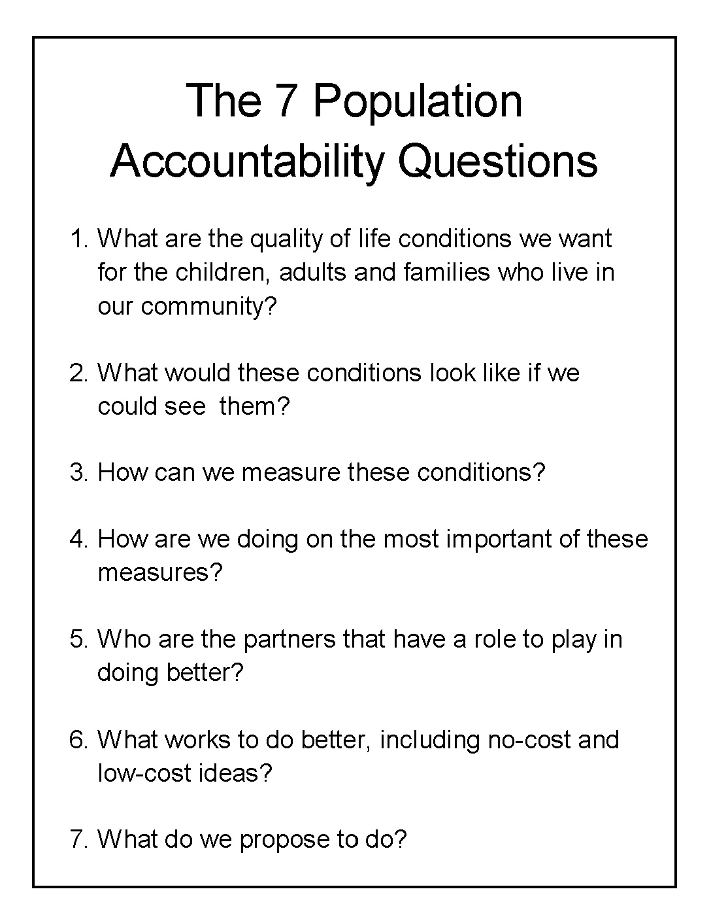

Slide 15
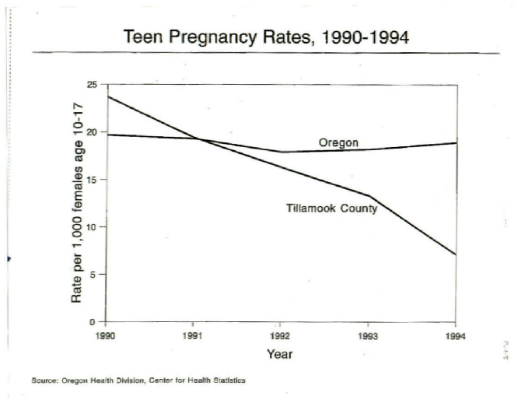
Notes:
Tillamook County was successful in bringing down the teen pregnancy rate, while the rest of Oregon stayed about the same.

Slide 16
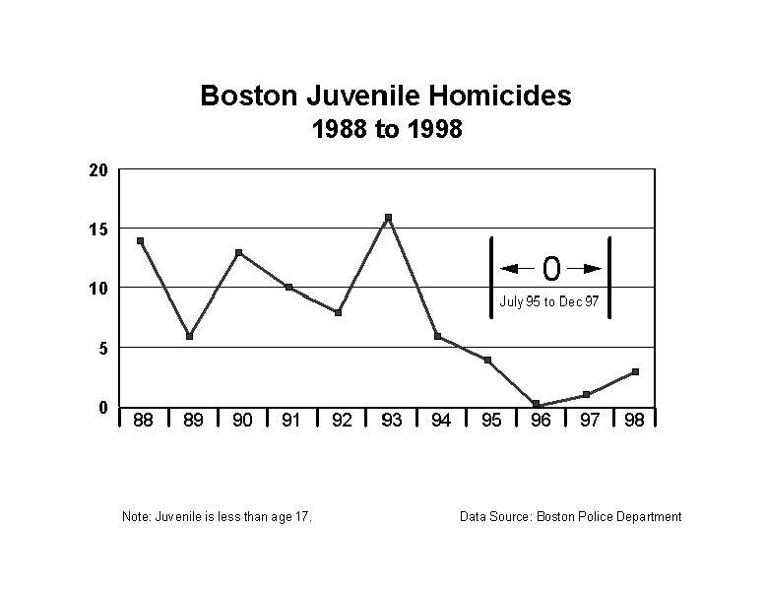

Slide 17


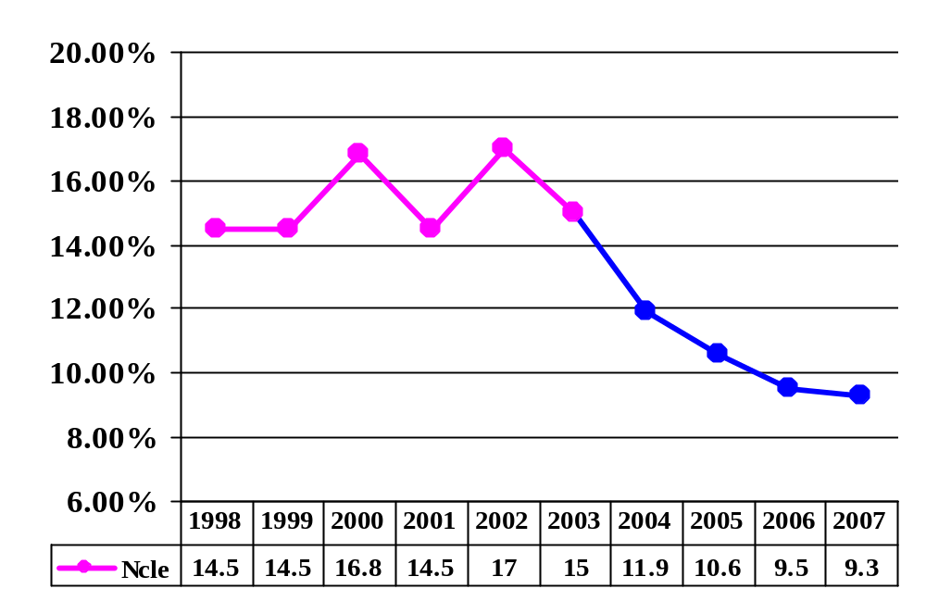
Newcastle, UK
Nov 08 – Jan 09
8.5
Revised 9 Nov 2007
Source: Connexions Tyne and Wear, UK
Notes:
This section presents instructions and reporting formats for the two turn the curve exercises, one for population accountability and one for performance accountability. And other exercises

Slide 18
Performance
Accountability
For Services, Agencies and Service Systems

Slide 19
Program Performance Measures
Quantity
Quality
How much did we do?
How well
did we do it?
Effect Effort
Is anyone
better off?
#
%
Notes:
Or an even simpler construction: How much did we do? How well did we do it? Is anyone better off?

Slide 20
Drug/Alcohol Treatment Program
How much did we do?
How well did we do it?
Number of
persons
treated
Unit
cost of
treatment
Is anyone better off?
Number of clients
off of alcohol & drugs
- at exit
- 12 months after exit
Percent of clients
off of alcohol & drugs
- at exit
- 12 months after exit
Notes:
Examples of measures for a typical drug and alcohol treatment program.

Slide 21
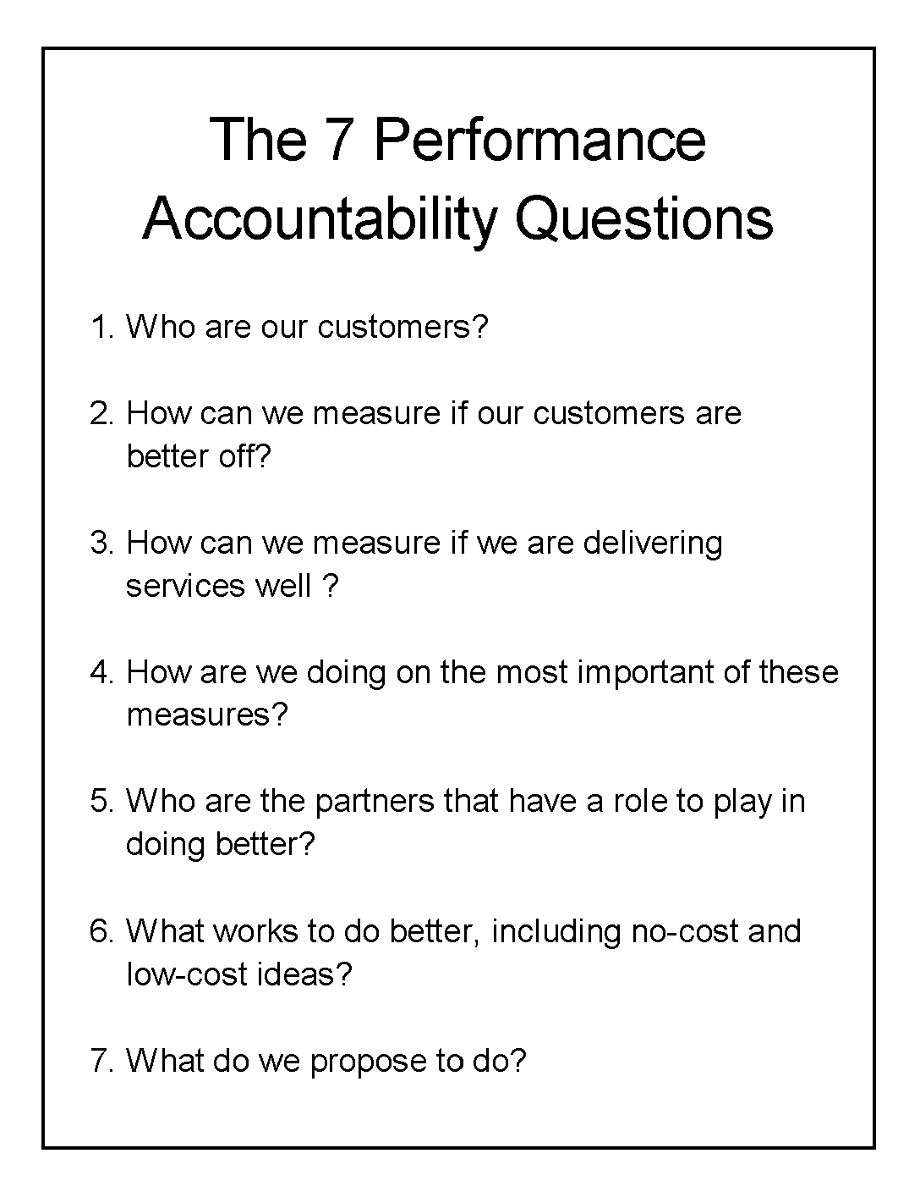
LR
UR
Notes:
Here is the thinking process in the form of 7 plain language common sense questions.
These questions should be asked an answered periodically (monthly, quarterly) at every intersection of supervision from the top to the bottom of the organization.
This is the most important take-away page for performance measurement. It can be used immediately without any further training.

Slide 22
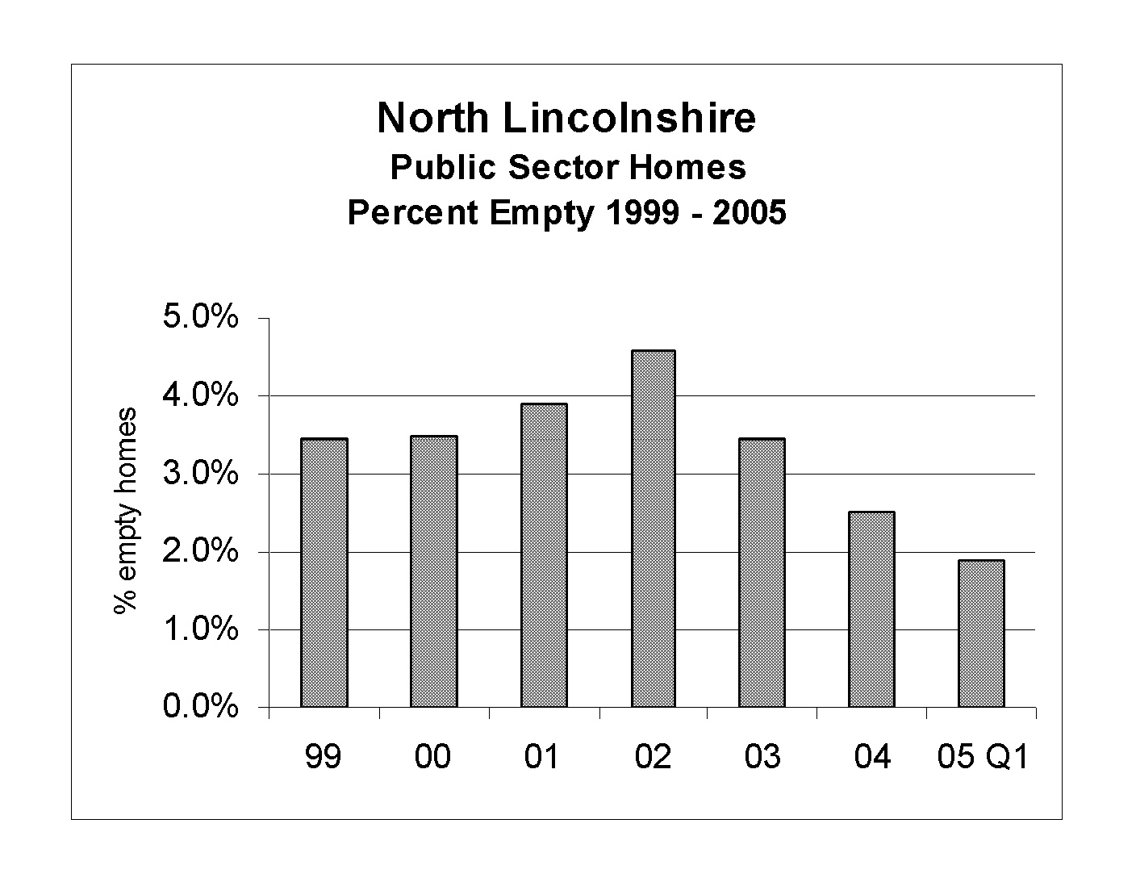

Slide 23
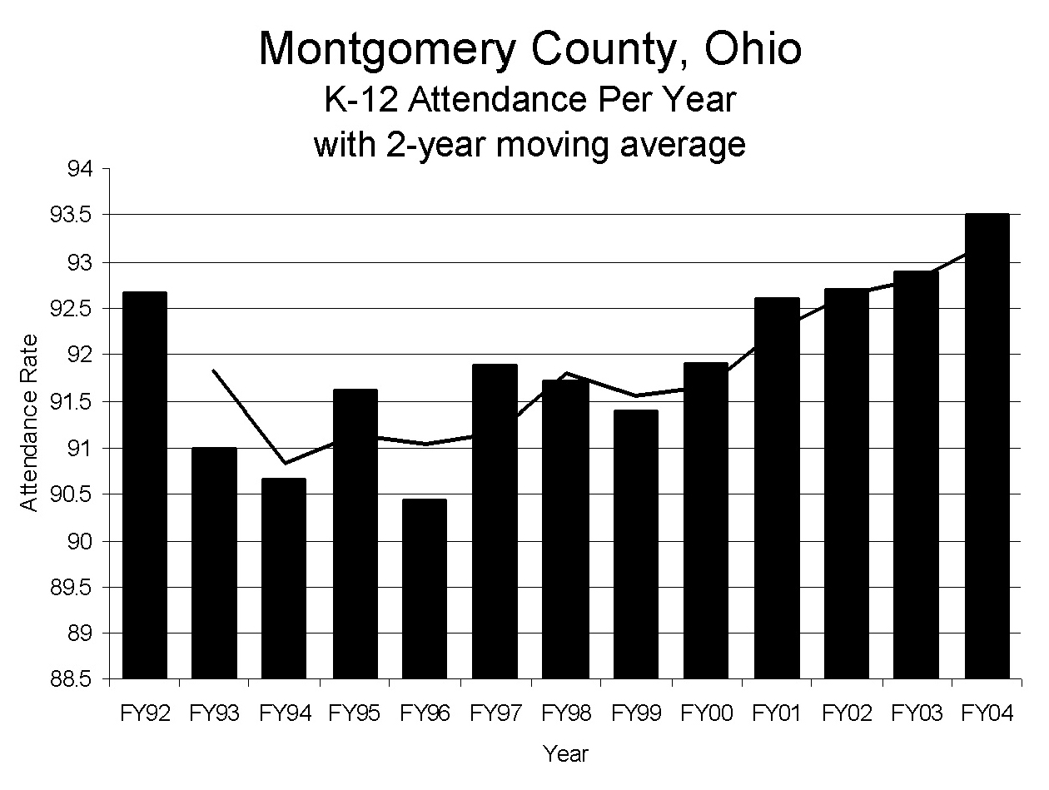

Slide 24
How
Population
&
Performance Accountability
FIT TOGETHER
Notes:
We’ve talked about two different kinds of accountability. Now let’s look at how they fit together.

Slide 25
THE LINKAGE Between POPULATION and PERFORMANCE
POPULATION ACCOUNTABILITY
Healthy Births
Rate of low birth-weight babies
Stable Families
Rate of child abuse and neglect
Children Ready for School
Percent fully ready per K-entry assessment
POPULATION
RESULTS
Contribution
relationship
PERFORMANCE ACCOUNTABILITY
Alignment
of measures
Child Welfare Program
Child Welfare Program
# of
investigations
completed
% initiated
within 24 hrs
of report
Appropriate
responsibility
# repeat
Abuse/Neglect
% repeat
Abuse/Neglect
CUSTOMER
RESULTS
Notes:
The relationship is a “contribution” relationship, not a cause and effect relationship. What we do for our customers is our contribution to what we and our partners are trying to do across the community.
Often the only difference between a population indicator and a lower right (Is anyone better off?) performance measure is the difference in scale between a client population and the total population.
This allows us to think about how our work is aligned with what we are trying to accomplish across the community. It allows us to think about how the measures we use at the program level relate to those at the population level. And it allows us to avoid the trap of holding programs responsible for population level change. We can hold program responsible for what they do for their clients. We must hold ourselves, across the community, responsible for the well being of the population.

Slide 26
IN CLOSING

Slide 27
“If you do what you always did, you will get what you always got.”
Kenneth W. Jenkins
President, Yonkers NY NAACP

Slide 28
Never be afraid to try something new. Remember that a lone amateur
built the Ark.
A large group
of professionals built the Titanic.
- Dave Barry

Slide 29
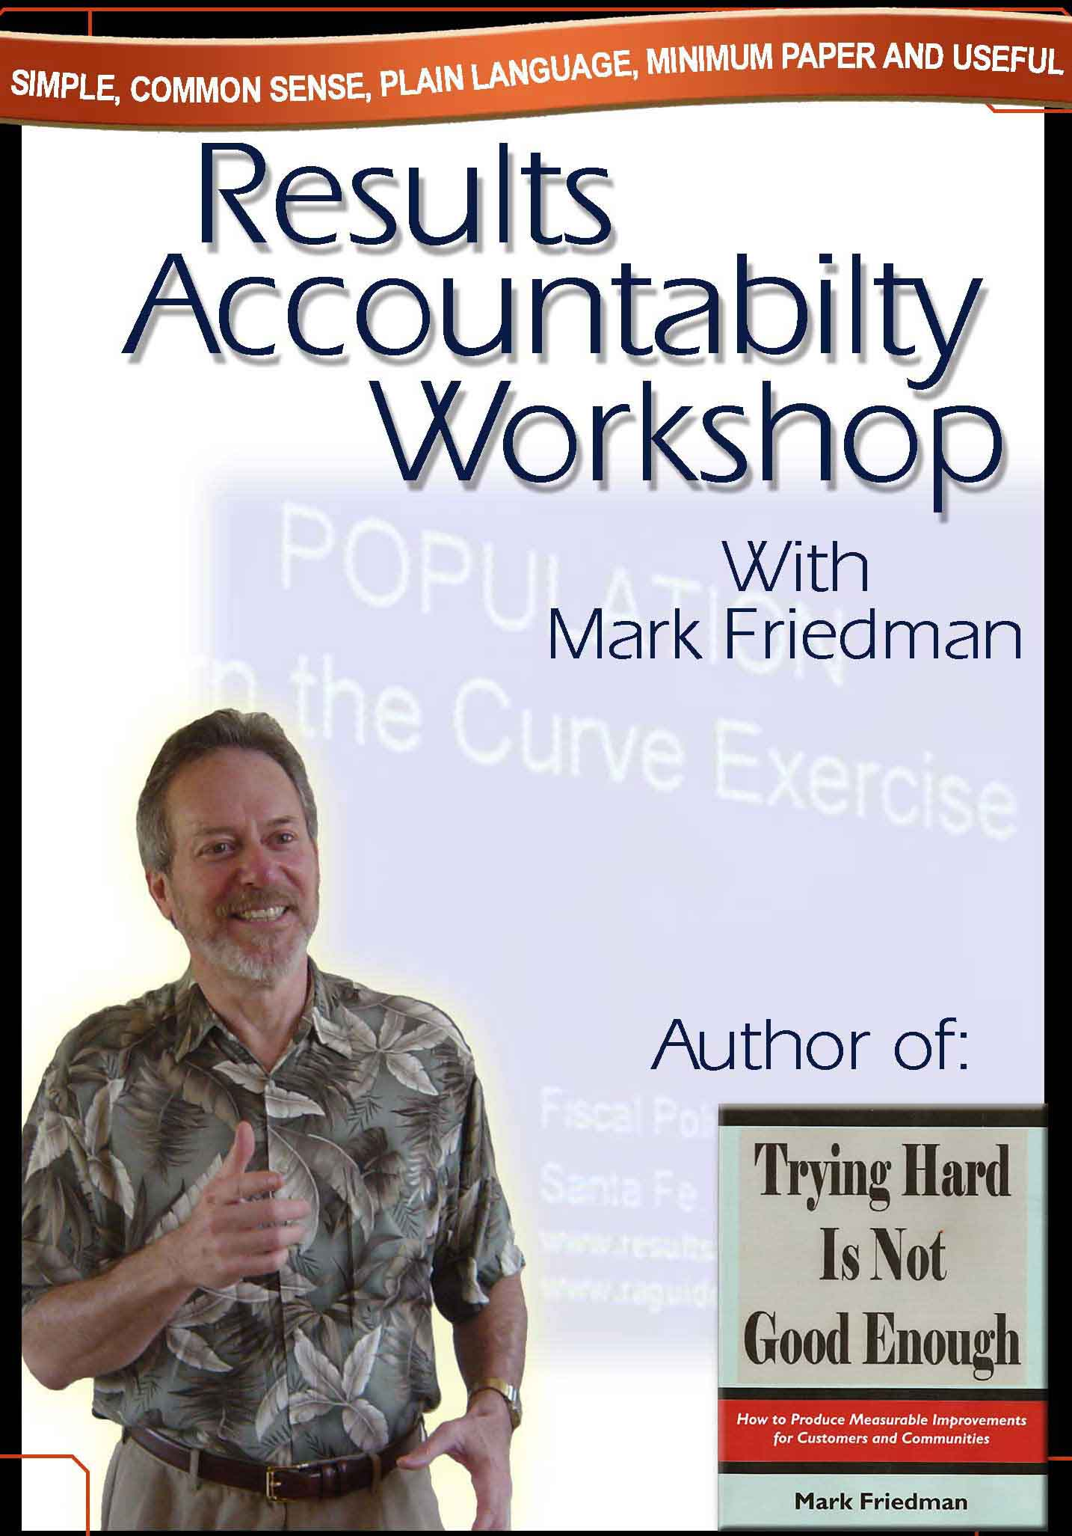
THANK YOU !
Websites
raguide.org
resultsaccountability.com
Book - DVD Orders
amazon.com
resultsleadership.org

